Slide 1
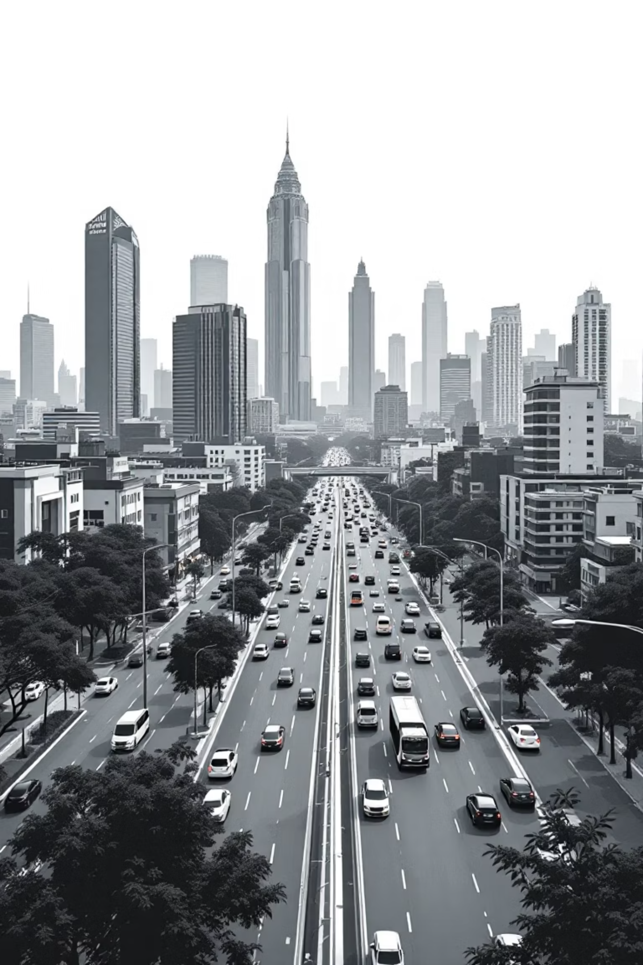
Bangalore FlowFast
Dynamic Traffic Optimization & Routing System
A next-generation traffic solution that moves beyond reactive navigation to predictive, simulation-based routing for India's most congested urban corridors.

Slide 2
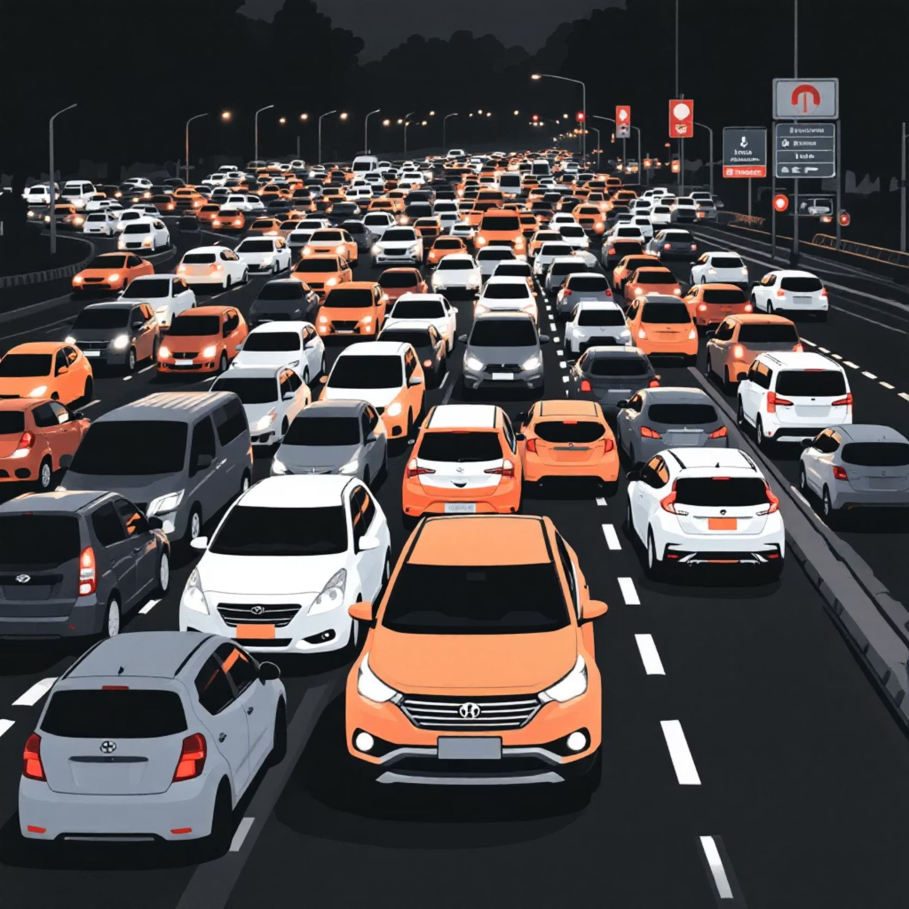

The Gridlock Challenge
The Real Problem
Bengaluru's traffic congestion creates massive economic and social costs. Current navigation tools are reactive—they rely on historical data or GPS pings but fail to model the root causes of delays.
Existing systems don't predict how queue lengths at signals cascade through the network, leaving drivers stuck in congestion that could have been avoided.

Slide 3
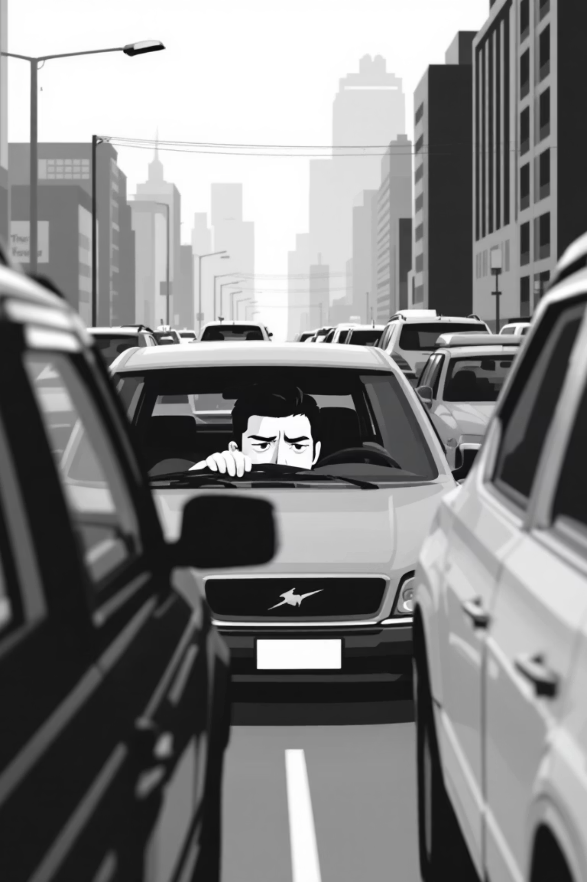



Why Traditional Navigation Falls Short
Historical Data Only
Missing Signal Logic
Routes based on past patterns, not real-time predictions
No modeling of queue lengths or traffic light cycles
No Cascade Analysis
Fails to predict how delays ripple through connected roads

Slide 4
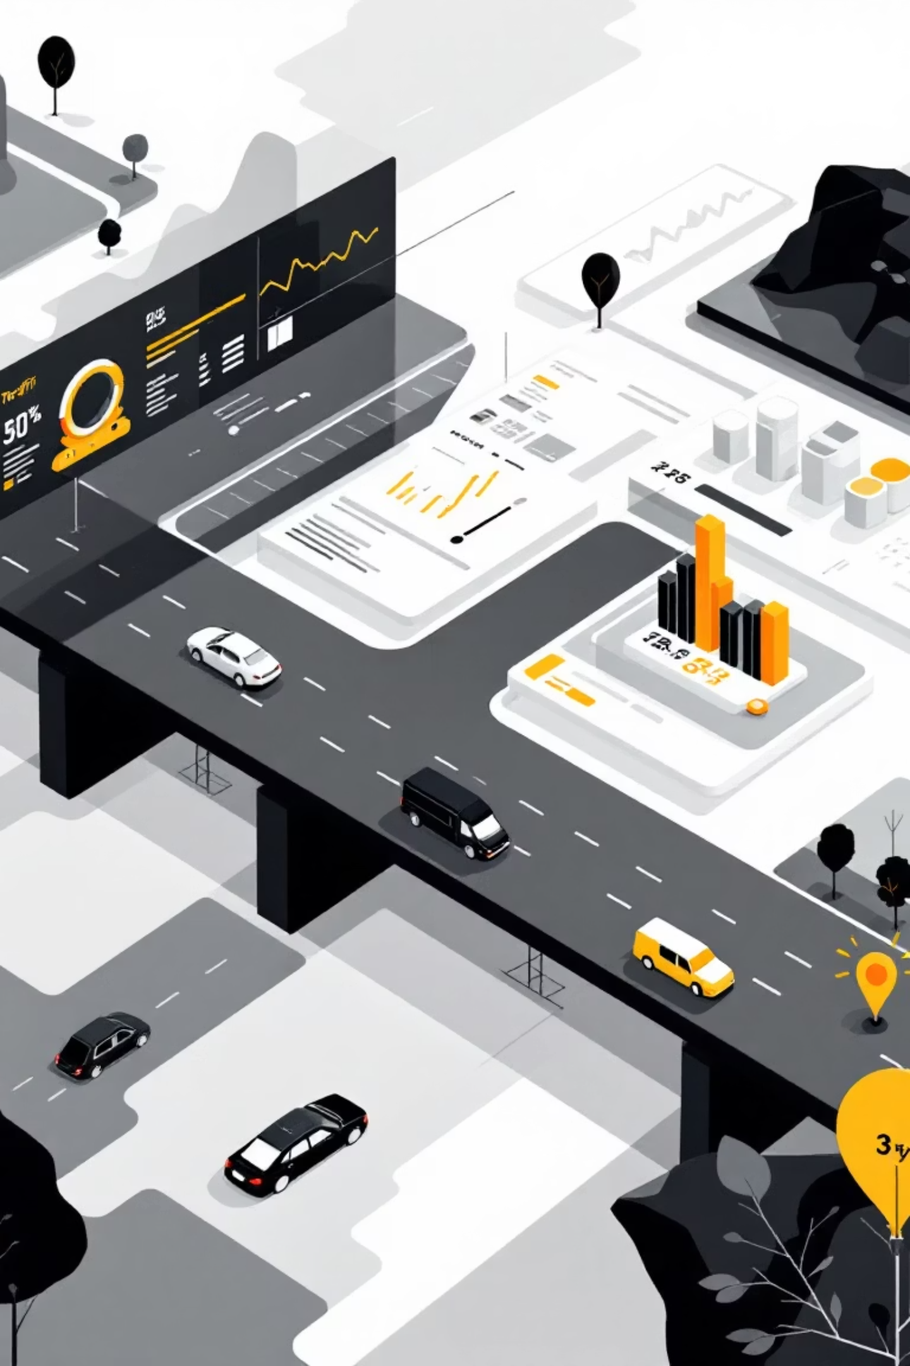


Introducing Bangalore FlowFast
A web-based application delivering optimal routes through a live, self-correcting traffic simulation. Unlike competitors, we don't just track congestion—we predict and prevent it.
Interactive Frontend
Clean UI with real-time traffic visualization across the entire network
Simulation Engine
Flask backend continuously models traffic flow and updates routing intelligence

Slide 5


System Architecture
Frontend Layer
Backend Engine
Built with HTML, Leaflet.js, and JavaScript. Users select start/end points from key junctions. Live map displays traffic conditions color-coded: Green/Yellow/Red.
Flask server runs continuous real-time simulation. Updates internal "live graph" every few seconds with APScheduler managing background processes.

Slide 6








The Continuous Feedback Loop
Traffic Simulation
Base Network
New cars arrive at smart intersections and enter virtual queues
Static map of junctions with standard travel times
Dynamic Update
Signal Processing
System recalculates delays based on queue lengths every 10 seconds
Traffic lights clear cars from longest queues at each intersection
This innovative feedback mechanism ensures the live graph reflects actual traffic conditions, enabling proactive route optimization.

Slide 7
Core Technology Stack
Algorithms & Data Structures
Graph Adjacency Lists
Built on proven computer science fundamentals for maximum efficiency and reliability.
Weighted graphs using Python dictionaries map junctions to neighbors with travel times
Dijkstra's Algorithm
Finds shortest path from source to all nodes in weighted graph—perfect for route optimization
Priority Queue (Min-Heap)
Python's heapq ensures exploration of most promising paths first for maximum performance
FIFO Queues & Hash Maps
Deques simulate traffic lines; dictionaries enable O(1) lookups for critical operations

Slide 8
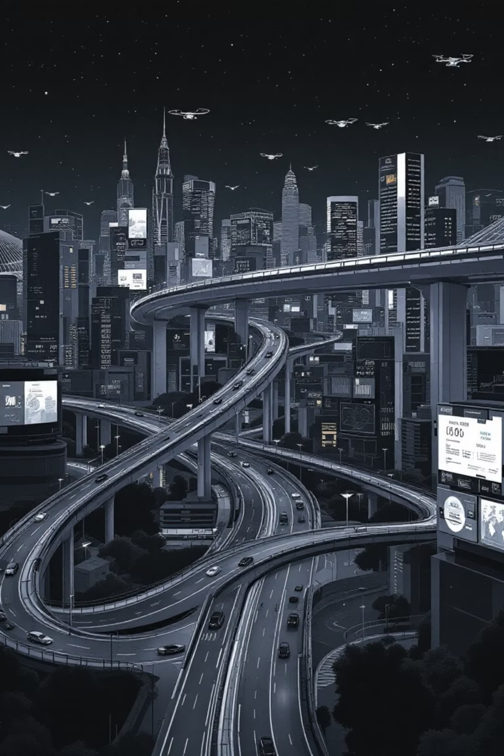
What Makes Us Different
We're a Simulation Engine
Dynamic Feedback Loop
Not just a data aggregator. We model the queues causing jams and predict delays with precision.
Our live graph is recalculated every 10 seconds based on simulated traffic flow—truly adaptive routing.
Proactive, Not Reactive
We route around the cause of delays (queues), not just the symptom (slow traffic), preventing gridlock before it happens.
https://flowfast.netlify.app/

Slide 9
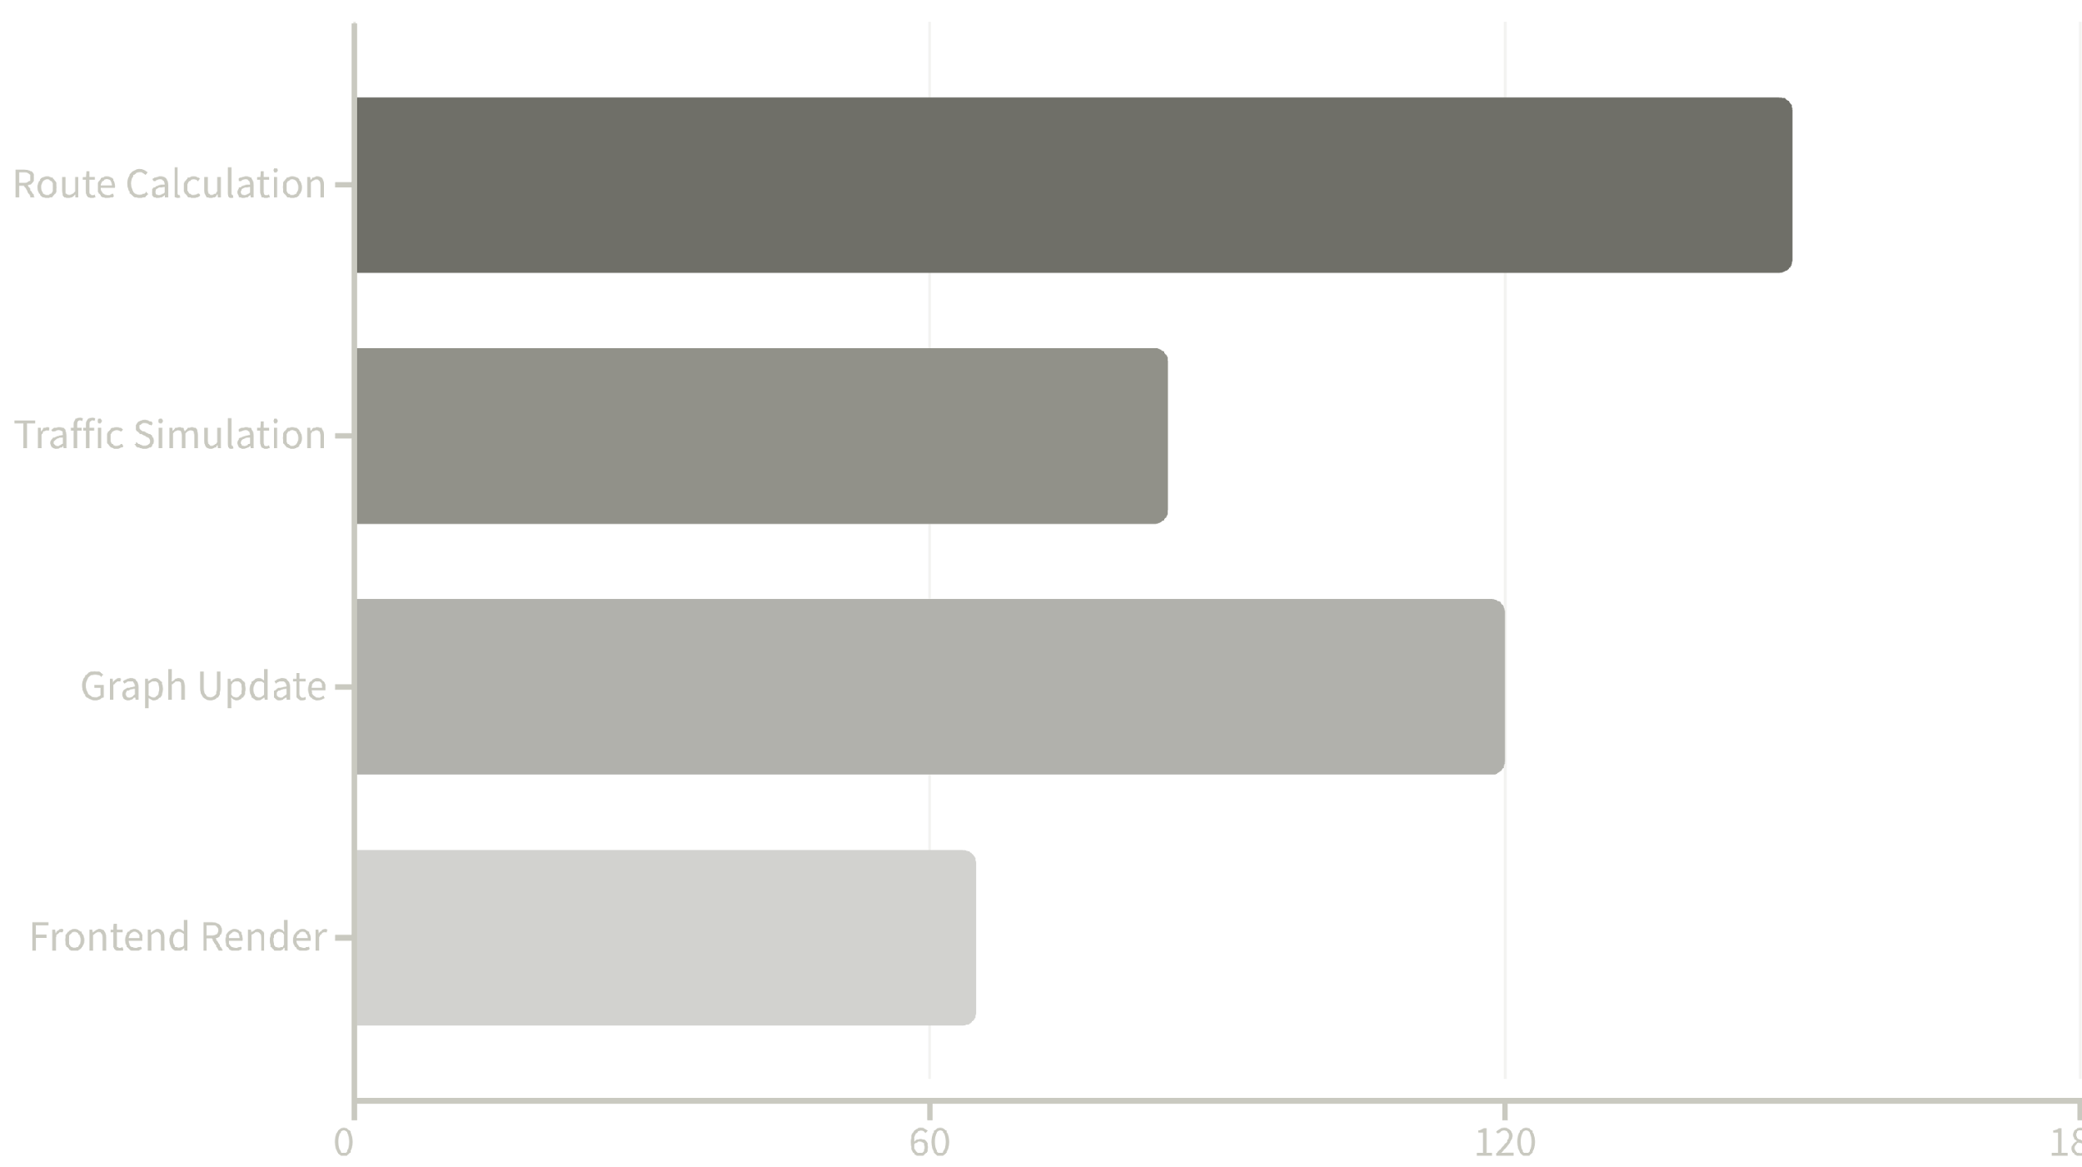
Prototype Performance Metrics
10s
100%
O(1)
Update Frequency
Functional
Lookup Speed
Live graph recalculation interval for real-time accuracy
End-to-end working prototype demonstrating core concept
Hash map performance for critical junction operations

Slide 10



Roadmap & Future Enhancements
Mobile Application
Network Expansion
Develop native iOS and Android apps for seamless on-the-go navigation and turn-by-turn directions
Real-World Data Integration
Scale city_graph to include granular coverage of all Bengaluru neighborhoods and arterial roads
Replace random car generation with live feeds from traffic cameras and IoT sensors to seed the simulation
Bangalore FlowFast represents the future of urban mobility: predictive, intelligent, and built to scale. Our prototype proves the concept—now we're ready to transform Bengaluru's traffic landscape.

